Slide 1
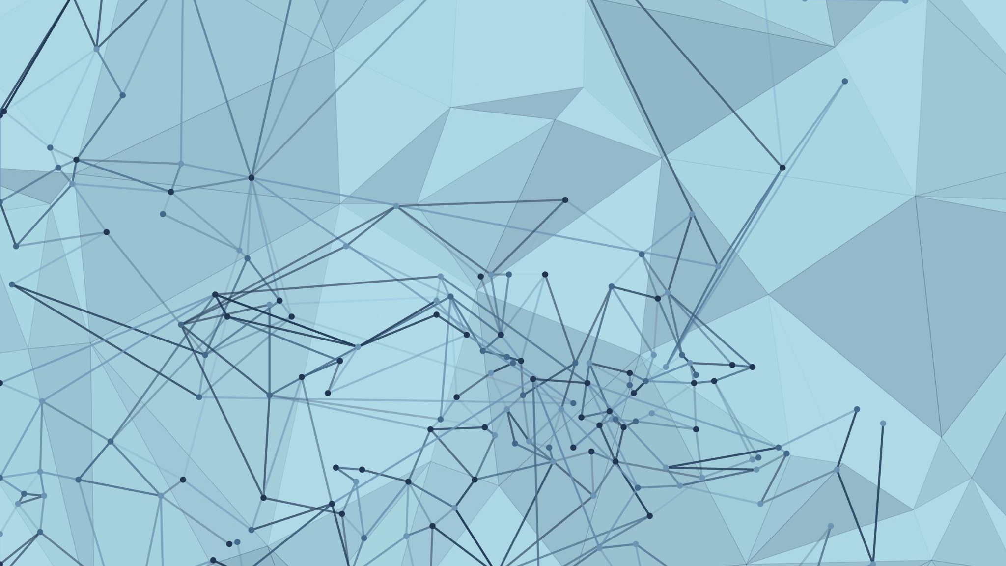
Deep Learning
Qishi Machine Learning Study Group

Slide 2
Table of Contents
Real World Applications
A Little Bit of History
Neural Network
Forward propagation
Universality Theorem
Backward propagation
Batch methods
Regularization
Bayesian Neural Network
Toolkits
Deep learning models

Slide 3
Neural networks
A beautiful biologically-inspired programming paradigm which enables a computer to learn from observational data
Deep learning
A powerful set of techniques for learning in neural networks

Slide 4
Real World Applications
ChatGPT
Self-driving
Disease detection
Pixel restoration
Picture to picture translation; picture/language translation
Mail sorting - Optical Character Recognition (OCR)
AlphaGo
And a lot more…

Slide 5
A Little Bit of History
Neural networks became famous in the late 1980s.
SVMs, boosting, and random forests came along, and neural networks became less popular.
Neural networks resurfaced after 2010. Successes in problems such as image and video classification, speech and text modeling. Success might be attributable to ever-larger training datasets, made possible by the wide-scale use of digitization in science and industry.
e.g. ImageNet and the ImageNet Challenge by Dr. Feifei Li

Slide 6
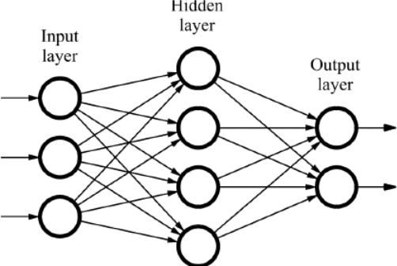
Neural Network
What does a neural network look like?
Simple version

Slide 7
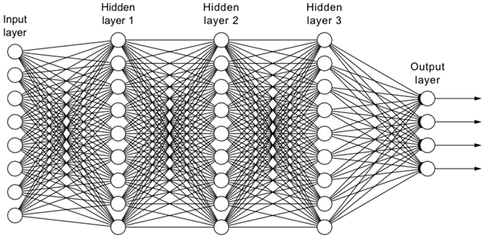
Neural Network
What does a neural network look like?
More complicated version: we can have infinite number of nodes and layers.

Slide 8
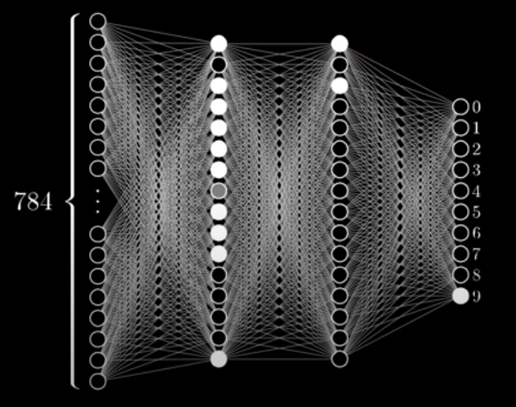
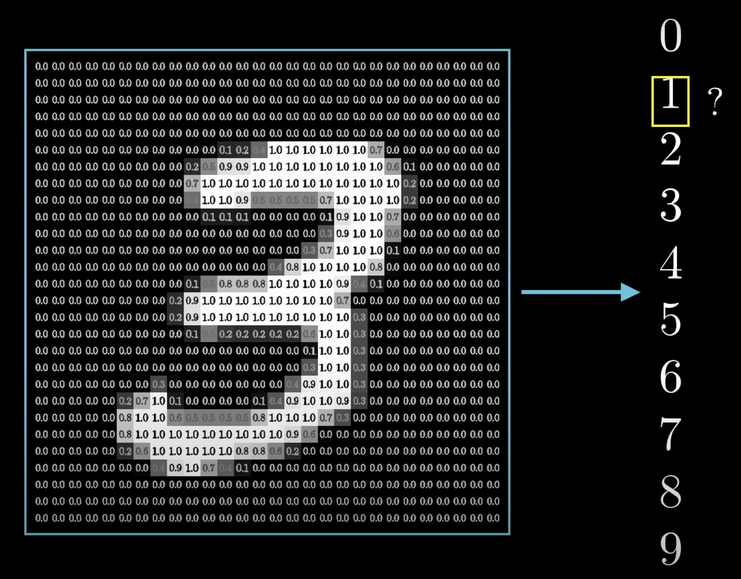
Neural Network
Example: recognize the number in the image
Input: one vector (not matrix) of real values between 0 and 1, indicating brightness
Output: a 1x10 vector of real values between 0 and 1, indicating how likely the image is that value

Slide 9
Neural Network
Essence - two pass:
Forward propagation to compute the error (initialize weights randomly)
Backward propagation to find the weight adjustment (gradient descent)

Slide 10
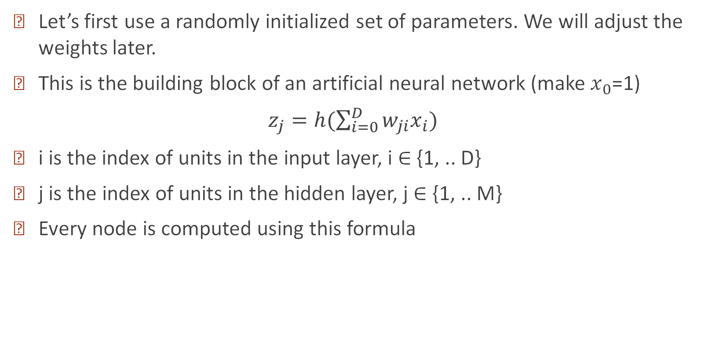
Neural Network - Forward Propagation
Let’s first use a randomly initialized set of parameters. We will adjust the weights later.
This is the building block of an artificial neural network (make $x_{0}$=1)
$z_{j}=h(\sum_{i=0}^{D}{w_{ji}x_{i})}$
i is the index of units in the input layer, i ∈ {1, .. D}
j is the index of units in the hidden layer, j ∈ {1, .. M}
Every node is computed using this formula

Slide 11
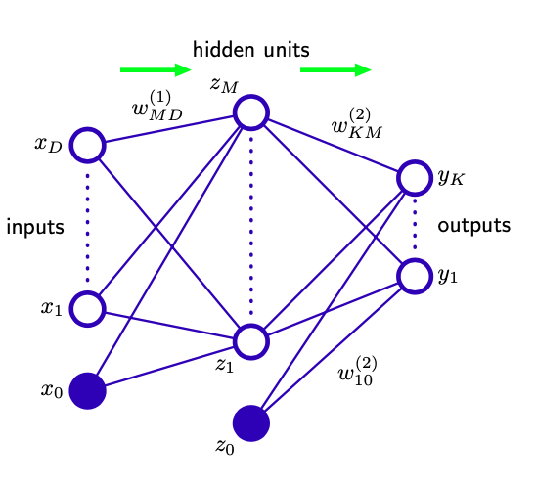
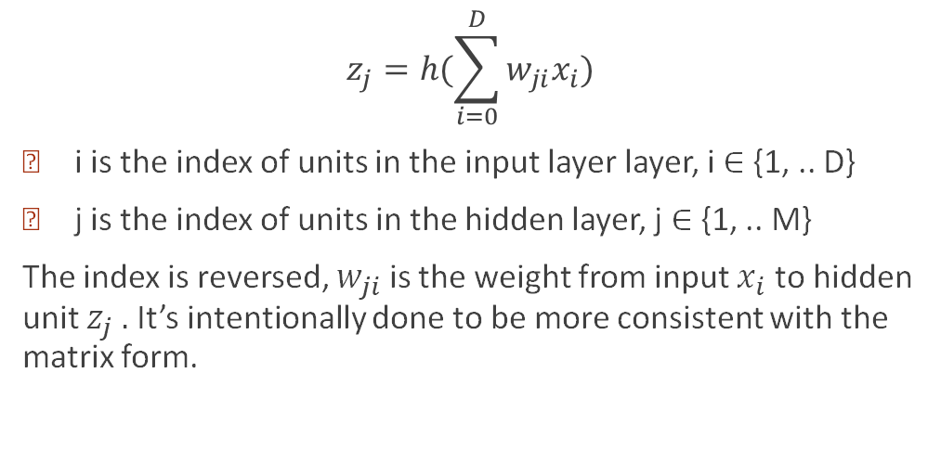
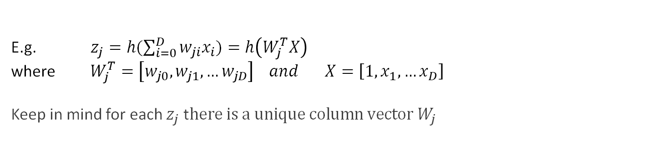
Neural Network - Forward Propagation
$$z_{j}=h(\sum_{i=0}^{D}{w_{ji}x_{i})}$$
i is the index of units in the input layer layer, i ∈ {1, .. D}
j is the index of units in the hidden layer, j ∈ {1, .. M}
The index is reversed, $w_{ji}$ is the weight from input $x_{i}$ to hidden unit $z_{j} .$It’s intentionally done to be more consistent with the matrix form.
E.g. $z_{j}=h(\sum_{i=0}^{D}{w_{ji}x_{i})=h\left(W_{j}^{T}X\right)}$
where $W_{j}^{T}=\left[w_{j0},w_{j1},…w_{jD}\right] and X=\left[1,x_{1},…x_{D}\right]$
Keep in mind for each $z_{j}$ t$here is a unique column vector W_{j}$

Slide 12
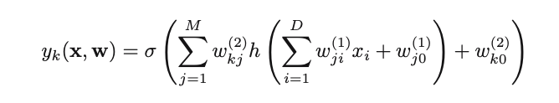
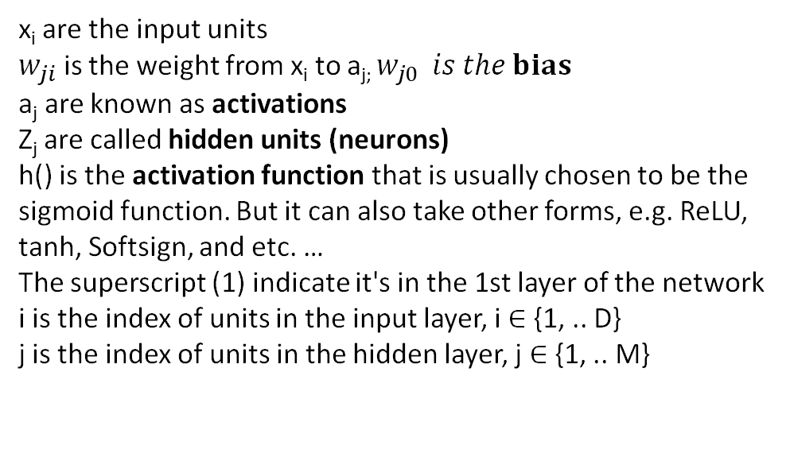
Neural Network - Forward propagation
a_{j}
Z_{j}=h(a_{j})
x_{i} are the input units
$w_{ji}$ is the weight from x_{i} to a_{j;} $w_{j0} is the bias$
a_{j} are known as activations
Z_{j} are called hidden units (neurons)
h() is the activation function that is usually chosen to be the sigmoid function. But it can also take other forms, e.g. ReLU, tanh, Softsign, and etc. …
The superscript (1) indicate it's in the 1st layer of the network
i is the index of units in the input layer, i ∈ {1, .. D}
j is the index of units in the hidden layer, j ∈ {1, .. M}

Slide 13

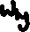


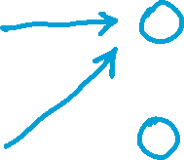

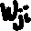




Neural Network - Forward propagation
--
We keep repeating this forward propagation process and add new layers to the network.
The activation function h(·) can also be different from each other when there are multiple hidden layers.
The activation function is important. The neural network collapses to linear without the activation function.

Slide 14
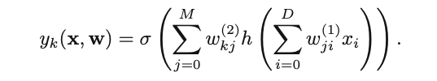








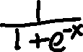
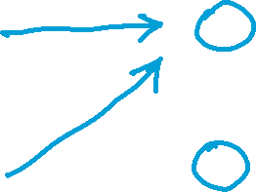











Example
--

Slide 15









Example
--

Slide 16
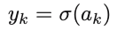
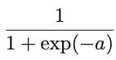
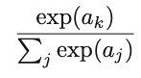
Neural Network
Once we arrive at the last layer, we need to compute the predicted output using
… What is σ(·)?
Regression: σ(·) is the identity so that y_{k} = a_{k}.
Multiple binary classification: σ(·) is the logistic sigmoid function
Multiclass problems: σ(·) is the softmax function

Slide 17
Intuition
The weights describe how strong the linkage is between two neurons
The biases describe how likely the neuron is going to be active

Slide 18
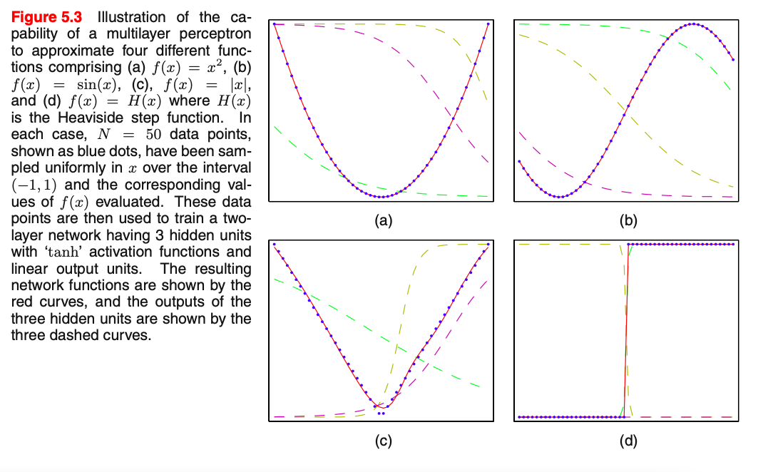
Neural Network - Universality Theorem

Slide 19
Neural Network - Universality Theorem
No matter what the function, there is guaranteed to be a neural network so that for every possible input, x, the value f(x) (or some close approximation) is output from the network.
This universality theorem holds even if we restrict our networks to have just a single hidden layer.
Explanation:
http://neuralnetworksanddeeplearning.com/chap4.html

Slide 20
Neural Network - Forward propagation
We keep repeating the forward propagation process in each layer to propagate information through the network.
...How to find the values of ω?

Slide 21
Neural Network - Training
We will discuss the below backpropagation examples:
one hidden layer, one neuron in each layer
one hidden layer, two neurons in the hidden layer
two output units
We will also discuss different batch methods:
backpropagation is on one data point in the sample. batch methods deal with handling multiple data points in the sample

Slide 22
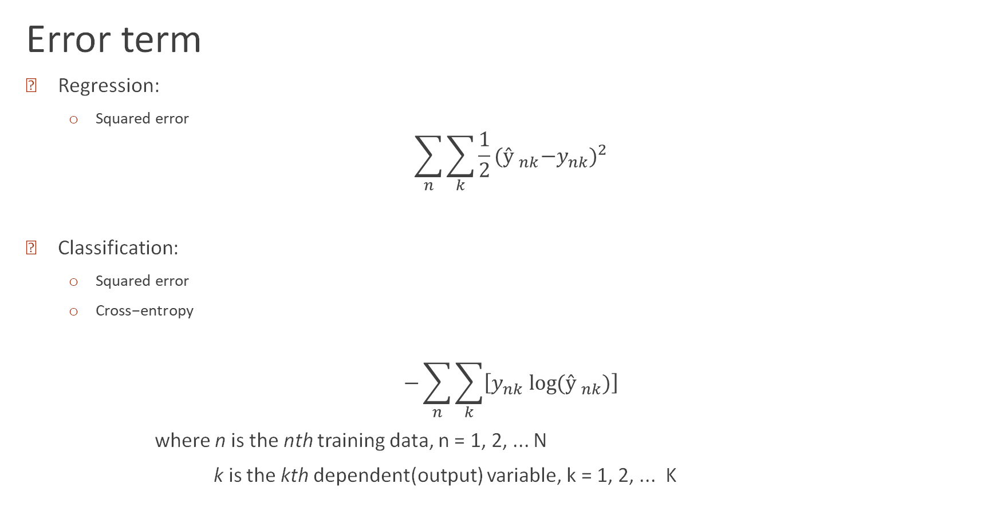


Neural Network - Error
Error term
Regression:
Squared error
$$\sum_{n}{\sum_{k}{{\frac{1}{2}({ŷ }_{nk}{−y}_{nk})}^{2}}}$$
Classification:
Squared error
$\text{Cross}\text{−}\text{entropy}$
$$−\sum_{n}{\sum_{k}{\left[y_{nk} log⁡({ŷ }_{nk})\right]}}$$
where n is the nth training data, n = 1, 2, ... N
k is the kth dependent(output) variable, k = 1, 2, ... K

Slide 23
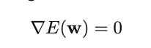

Neural Network – backpropagation
- The error function is not convex.
- No analytical solution
- We look for the local minima s.t.
For ANN (artificial neural network), the gradient descent process is called backpropagation.

Slide 24
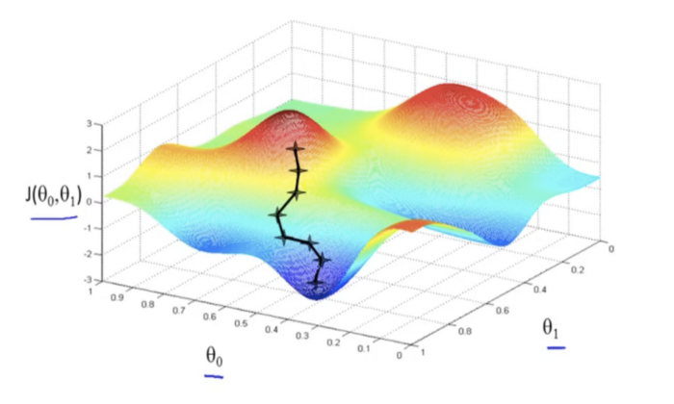


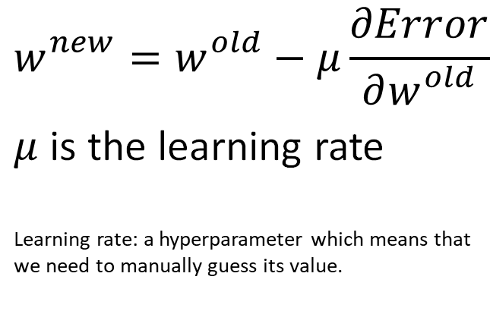


Neural Network - Backpropagation
$$w_{}^{new}=w_{}^{old}−μ\frac{∂Error}{∂w_{}^{old}}$$
$μ$ is the learning rate
Learning rate: a hyperparameter which means that we need to manually guess its value.

Slide 25
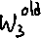
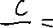

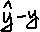



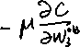



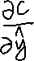

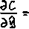
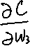
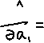

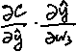
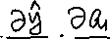
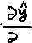
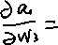









Neural Network – back propagation
one hidden layer, one neuron each layer

Slide 26
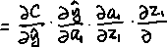

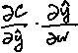



Neural Network – back propagation
one hidden layer, one neuron each layer

Slide 27





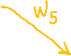
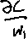
Neural Network – back propagation
one hidden layer, two neurons in the hidden layer
Same formulas!

Slide 28




Neural Network – back propagation
two output units

Slide 29
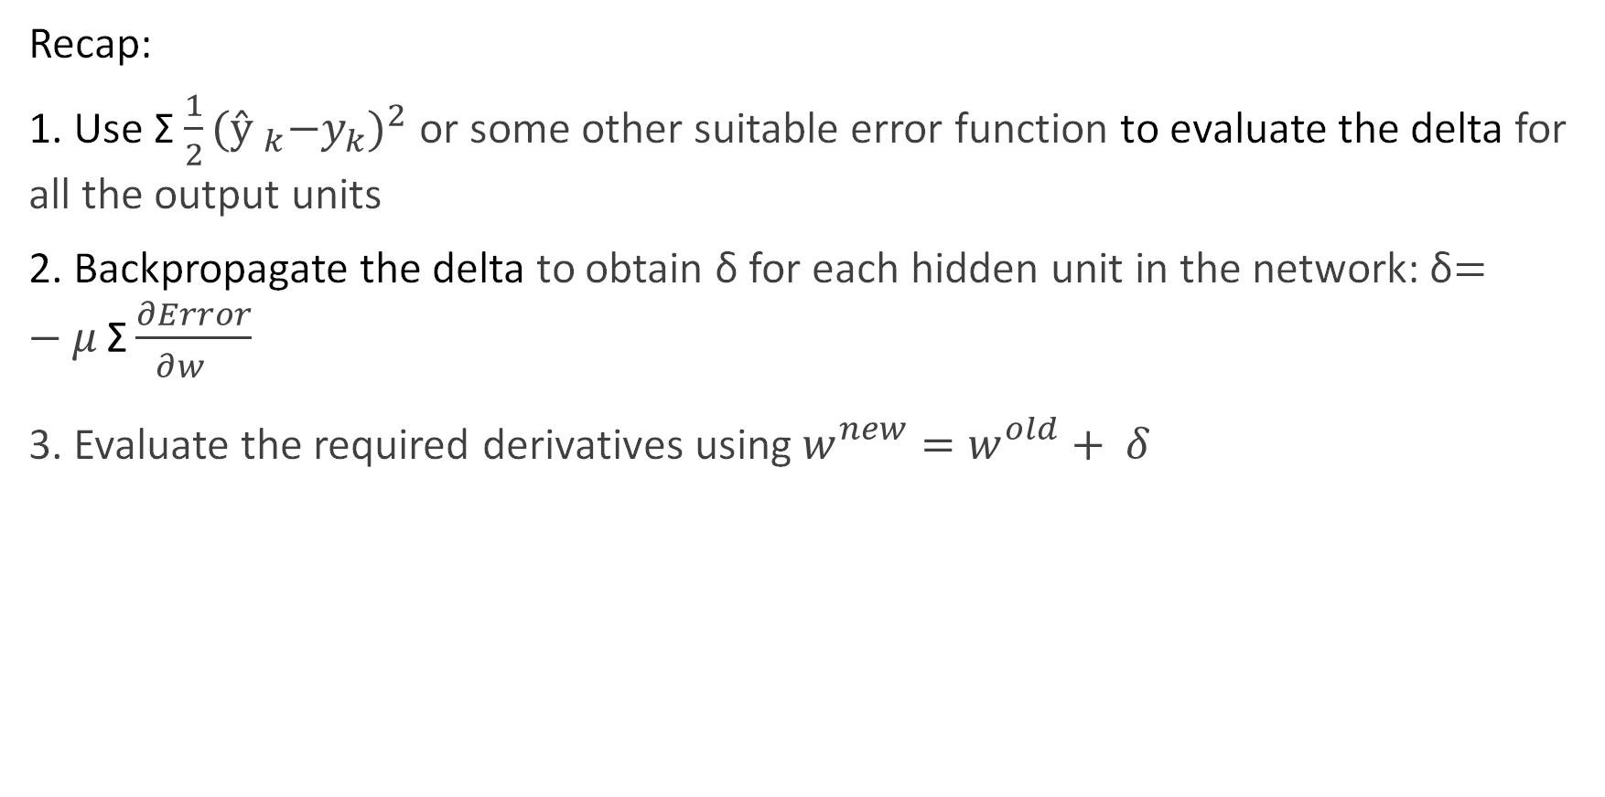

Neural Network - Backpropagation
Recap:
1. Use Σ ${\frac{1}{2}({ŷ }_{k}{−y}_{k})}^{2}$ or some other suitable error function to evaluate the delta for all the output units
2. Backpropagate the delta to obtain δ for each hidden unit in the network: δ$=−μ \text{Σ}\frac{∂Error}{∂w_{}^{}}$
3. Evaluate the required derivatives using $w_{}^{new}=w_{}^{old}+ δ$

Slide 30
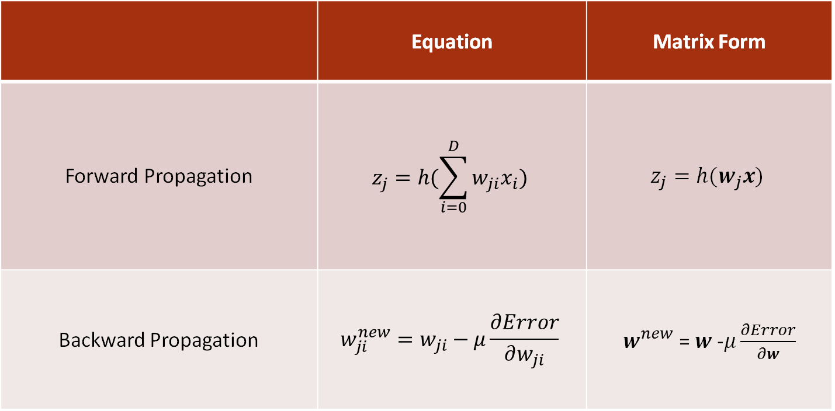
Neural Network – Matrix Form
 | Equation | Matrix Form
Forward Propagation | $$z_{j}=h(\sum_{i=0}^{D}{w_{ji}x_{i})}$$ | $$z_{j}=h(w_{j}x)$$
Backward Propagation | $$w_{ji}^{new}=w_{ji}−μ\frac{∂Error}{∂w_{ji}}$$ | $w_{}^{new}$ = $w$ -$μ\frac{∂Error}{∂w}$

Slide 31
Neural Network – Batch Methods
When there are two or more data points in the training data set, each data point gives us a different set of new weights. What do we do?
Gradient Descent
parameters are updated based on the average gradient of the loss function over the entire training dataset
Faster convergence. Might take longer to compute.
Stochastic Gradient Descent
randomly sample a single example and use it to update the parameters
Slower convergence. Faster computation.
Mini-Batch Gradient Descent
a compromise between the above two methods
the training data is divided into small batches of size "n", where n is usually chosen to be a power of 2. The model parameters are updated based on the average gradient of the loss function over a batch of "n" training examples

Slide 32
Neural Network – Batch Methods
Batch learning: Batch Gradient Descent
Online Learning: Stochastic Gradient Descent; Mini-Batch Gradient Descent
Batch Learning vs Online Learning
Batch learning requires all data to be present before training, while online learning can start training as soon as data arrives
Batch learning trains the model on the entire dataset at once, while online learning trains the model incrementally on small subsets of data
Batch learning updates the model parameters only after processing the entire dataset, while online learning updates the model parameters after processing each mini-batch
Batch learning is typically used for offline training, while online learning is typically used in real-time or time-critical applications

Slide 33
Neural Network - Training
Start with parameters randomized near zero (model starts out near linear)
Starting with exact zero weights leads to zero derivatives and perfect symmetry, the algorithm never moves
Starting with large weights often leads to poor solutions
Preprocessing: scaling of the inputs
normalizing the input data to a standardized range
ensure input features have similar ranges and variances
improve the performance and training speed of neural networks.

Slide 34
Neural Network – Address Overfitting
Common ways to address overfitting:
Get more data
artificial expansion of the training data, e.g. rotate/crop/flip the input image
Reduce the complexity of neural network architecture
reduce the number of hidden layers
reduce the number of nodes
decrease some number of epochs
Use regularization
L1 and L2 regularization
Dropout
Early stopping

Slide 35
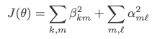
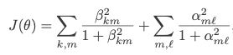
Neural Network - Regularization
Add penalty term to the error function
weight decay / Frobenius norm (similar to ridge)
Weight elimination penalty

Slide 36
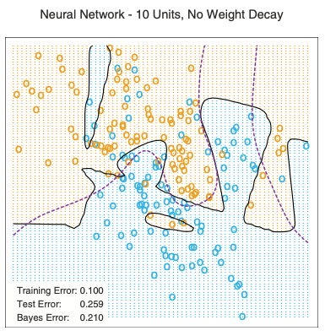
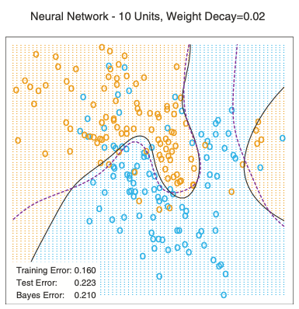

Slide 37
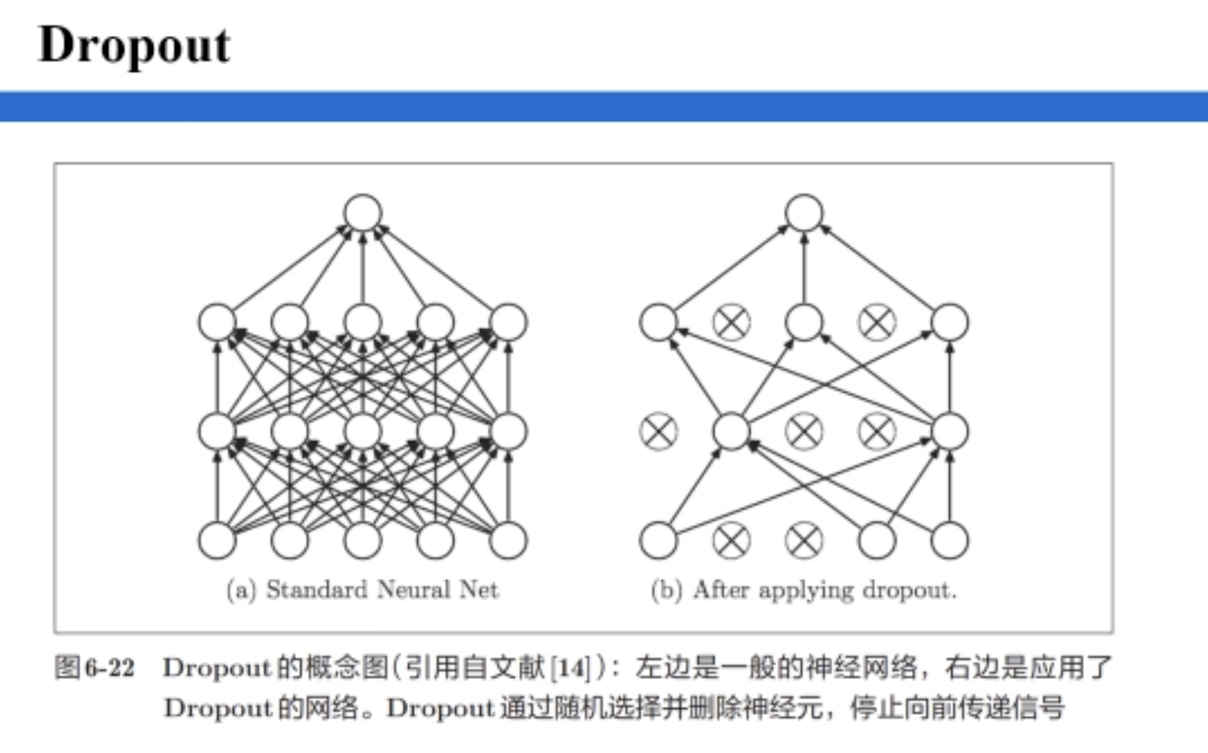
Neural Network - Regularization

Slide 38
Neural Network - Regularization
Dropout
Traditional dropout: dropping out the nodes (input and hidden layer) in a neural network. The nodes are dropped by a dropout probability of p.
Inverted dropout:
Inverted dropout scales the activations by the inverse of the keep probability q, where q =1-p
This prevents network’s activations from getting too large and does not require any changes to the network during evaluation.
Intuition: cannot rely on any one feature, so have to spread out weights

Slide 39
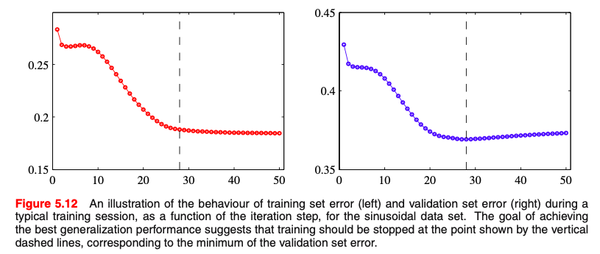
Neural Network - Regularization
Early Stopping: training should be stopped when validation error start to increase, i.e. at the minimum of the validation set error

Slide 40
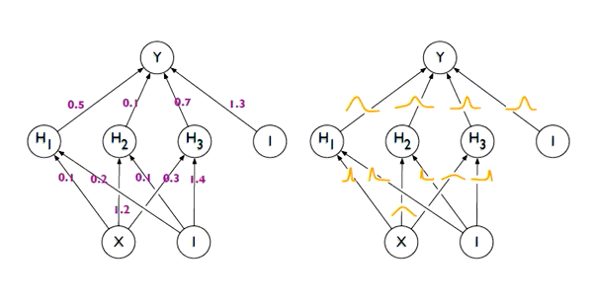
Neural Network – Bayesian Neural Networks (BNN)

Slide 41


Neural Network – Bayesian Neural Networks (BNN)
Capabilities:
Classification, regression, and reinforcement learning
Provide uncertainty estimates for their predictions
Can be trained using a variety of techniques, e.g.
Markov chain Monte Carlo (MCMC) sampling
variational inference
c.f.

Slide 42
Neural Network – Bayesian Neural Networks (BNN)
Advantages:
Provides uncertainty estimates for predictions (confidence interval)
Handles missing data and small datasets better
More robust to outliers and noisy data
Better regularization and prevents overfitting
Disadvantages:
Computationally expensive for large datasets and complex models
Challenging to choose appropriate prior distribution and hyperparameters
May not outperform traditional neural networks
Require more data to estimate uncertainty in predictions

Slide 43

Bayesian Neural Networks

Slide 44
Toolkits
• Theano
• Tensorflow (Google)
• PyTorch (Facebook)
• MXNet (Amazon)
• DyNet

Slide 45

Deep learning models
Let’s briefly discuss the concepts below without diving into details:
RNN and Transformers, LSTM
RNN: Recurrent Neural Network, process sequential data
maintain a "memory" or "context" of previous inputs

Slide 46
Deep learning models
RNN and Transformers, LSTM
RNN: Recurrent Neural Network, process sequential data
maintain a "memory" or "context" of previous inputs
natural language processing, speech recognition, and time series analysis
Transformers, LSTM (Long Short-Term Memory): variants of RNN

Slide 47

Deep learning models
CNN: Convolutional Neural Networks
Mainly for images: face recognition, auto driving, and etc.
We will discuss AlexNet in the next session

Slide 48
Deep learning models
Deep Generative Modeling
generate new examples of data
image and video synthesis, music generation, text generation, drug discovery
Reinforcement Learning
game playing, robotics, autonomous driving
develop novel algorithms for decision making in complex systems, such as financial markets and supply chains
Adversarial Attacks
making small, carefully crafted modifications to input data in order to cause the model to misbehave
can be used to exploit vulnerabilities in the model
Graph Convolutional Neural Network
operate on graph-structured data
social network analysis, molecular modeling, recommendation systems

Slide 49


